Slide 1
Concepts of MCP
Dr M Janaki Meena
Professor, SCOPE
VIT Chennai

Slide 2
Model Context Protocol (MCP)
Open-source standard for connecting AI applications to external systems
Like a USB-C port for AI applications.
Just as USB-C provides a standardized way to connect electronic devices, MCP provides a standardized way to connect AI applications to external systems

Slide 3
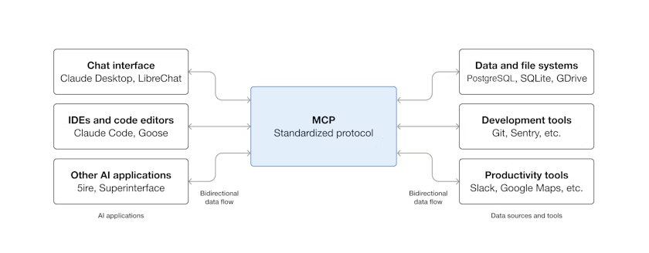
Model Context Protocol (MCP)

Slide 4
What can MCP do?
Agents can access your Google Calendar and Notion, acting as a more personalized AI assistant.
Claude Code can generate an entire web app using a Figma design.
Enterprise chatbots can connect to multiple databases across an organization, empowering users to analyze data using chat.
AI models can create 3D designs on Blender and print them out using a 3D printer.

Slide 5
Why MCP?
Developers: Reduces development time and complexity when building, or integrating with, an AI application or agent.
AI applications or agents: Provides access to an ecosystem of data sources, tools and apps which will enhance capabilities and improve the end-user experience.
End-users: MCP results in more capable AI applications or agents which can access your data and take actions on your behalf when necessary.

Slide 6
Scope
The Model Context Protocol includes the following projects:
MCP Specification: A specification of MCP that outlines the implementation requirements for clients and servers.
MCP SDKs: SDKs for different programming languages that implement MCP.
MCP Development Tools: Tools for developing MCP servers and clients, including the MCP Inspector
MCP Reference Server Implementations: Reference implementations of MCP servers.

Slide 7
Key participants in MCP architecture
MCP Host: AI application that coordinates and manages one or multiple MCP clients
MCP Client: A component that maintains a connection to an MCP server and obtains context from an MCP server for the MCP host to use
MCP Server: A program that provides context to MCP clients

Slide 8
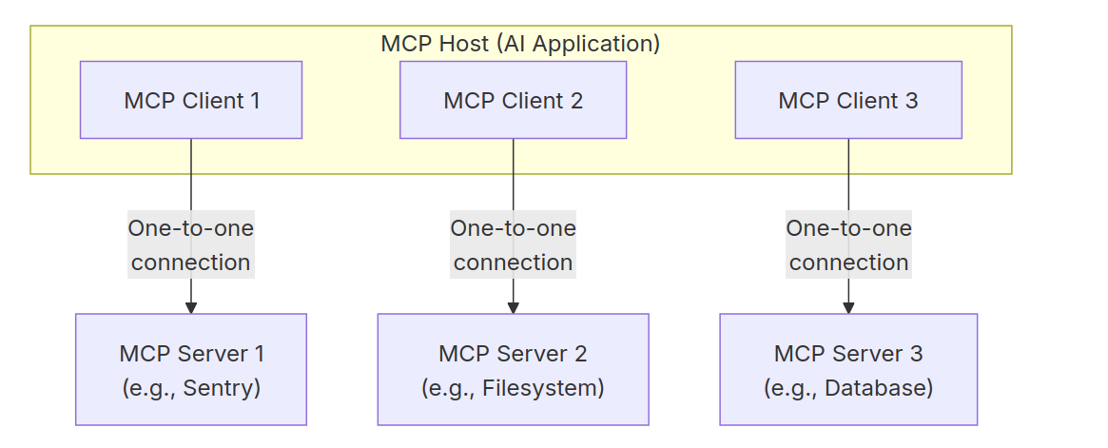
Key participants in MCP architecture

Slide 9
MCP Layers
Data layer: Defines the JSON-RPC based protocol for client-server communication, including lifecycle management, and core primitives, such as tools, resources, prompts and notifications.
Transport layer: Defines the communication mechanisms and channels that enable data exchange between clients and servers, including transport-specific connection establishment, message framing, and authorization.

Slide 10
Data layer
Lifecycle management: Handles connection initialization, capability negotiation, and connection termination between clients and servers
Server features: Enables servers to provide core functionality including tools for AI actions, resources for context data, and prompts for interaction templates from and to the client

Slide 11
Data layer
Client features: Enables servers to ask the client to sample from the host LLM, elicit input from the user, and log messages to the client
Utility features: Supports additional capabilities like notifications for real-time updates and progress tracking for long-running operations

Slide 12
Transport layer - Abstracts Communication Details
Stdio transport: Uses standard I/O streams for direct process communication between local processes on the same machine
Streamable HTTP transport: Uses HTTP POST for client-to-server messages with optional Server-Sent Events for streaming capabilities.
Enables remote server communication and supports standard HTTP authentication methods including bearer tokens, API keys, and custom headers.
MCP recommends using OAuth to obtain authentication tokens.

Slide 13
Data Layer Protocol
Part of MCP that defines the ways developers can share context from MCP servers to MCP clients
MCP uses JSON-RPC 2.0 as its underlying RPC protocol
Client and servers send requests to each other and respond accordingly
Notifications can be used when no response is required.

Slide 14
Lifecycle management
MCP is a stateful protocol that requires lifecycle management
The purpose of lifecycle management is to negotiate the capabilities that both client and server support.
Detailed information can be found in the specification, and the example showcases the initialization sequence.

Slide 15
Primitives
Most important concept within MCP that define what clients and servers can offer each other
Tools: Executable functions that AI applications can invoke to perform actions (e.g., file operations, API calls, database queries)
Resources: Data sources that provide contextual information to AI applications (e.g., file contents, database records, API responses)
Prompts: Reusable templates that help structure interactions with language models (e.g., system prompts, few-shot examples)

Slide 16
Primitives
Sampling: Allows servers to request language model completions from the client’s AI application.
Useful when servers’ authors want access to a language model, but want to stay model independent and not include a language model SDK in their MCP server.
They can use the sampling/complete method to request a language model completion from the client’s AI application.

Slide 17
Primitives
Elicitation: Allows servers to request additional information from users.
Useful when servers’ authors want to get more information from the user, or ask for confirmation of an action.
Logging: Enables servers to send log messages to clients for debugging and monitoring purposes.

Slide 18
Notifications
Protocol supports real-time notifications to enable dynamic updates between servers and clients.
Eg: When a server’s available tools change—a new functionality becomes available or existing tools modified—the server can send tool update notifications to inform connected clients about changes
Notifications are sent as JSON-RPC 2.0 notification messages without expecting a response

Slide 19
Example
Data Layer
Provides a step-by-step walkthrough of an MCP client-server interaction, focusing on the data layer protocol

Slide 20
Initialization (Lifecycle Management)
through a capability negotiation handshake
Client sends an initialize request to establish the connection and negotiate supported features.

Slide 21
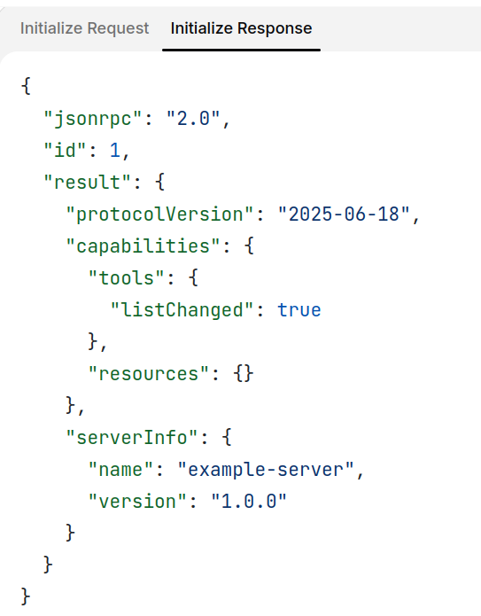
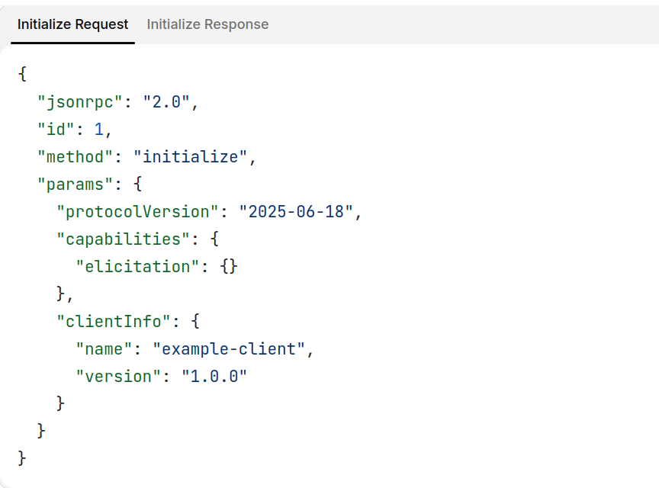
Initialization (Lifecycle Management)

Slide 22
Understanding the Initialization Exchange
Protocol Version Negotiation:
protocolVersion field (e.g., “2025-06-18”) ensures both client and server are using compatible protocol versions.
Prevents communication errors that could occur when different versions attempt to interact
If a mutually compatible version is not negotiated, the connection should be terminated.

Slide 23
Understanding the Initialization Exchange
Capability Discovery:
Allows each party to declare what features they support, including which primitives they can handle (tools, resources, prompts) and whether they support features like notifications.
Enables efficient communication by avoiding unsupported operations

Slide 24
Understanding the Initialization Exchange
Identity Exchange:
ClientInfo and serverInfo objects provide identification and versioning information for debugging and compatibility purposes.

Slide 25
Client Capabilities
"elicitation": {} - The client declares it can work with user interaction requests (can receive elicitation/create method calls)

Slide 26
Server Capabilities
"tools": {"listChanged": true} - Server supports the tools primitive AND can send tools/list_changed notifications when its tool list changes
"resources": {} - Server also supports the resources primitive (can handle resources/list and resources/read methods)

Slide 27
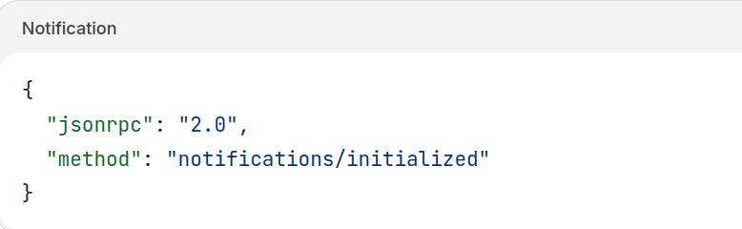
Successful Initialization Client Sends Notification

Slide 28
How This Works in AI Applications
During initialization, the AI application’s MCP client manager establishes connections to configured servers and stores their capabilities for later use.
The application uses this information to determine which servers can provide specific types of functionality (tools, resources, prompts) and whether they support real-time updates.

Slide 29
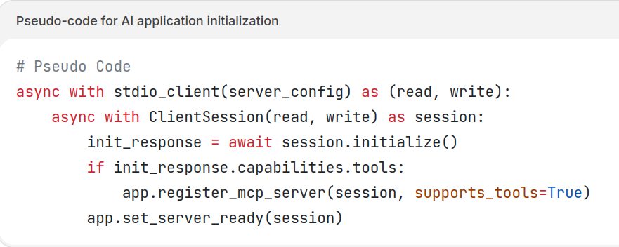
Pseudo-code for AI application initialization

Slide 30
Tool Discovery (Primitives)
Now that the connection is established, the client can discover available tools by sending a tools/list request.
This request is fundamental to MCP’s tool discovery mechanism — it allows clients to understand what tools are available on the server before attempting to use them.

Slide 31
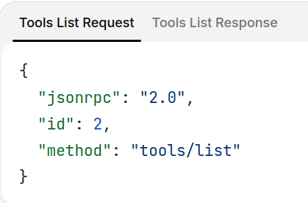
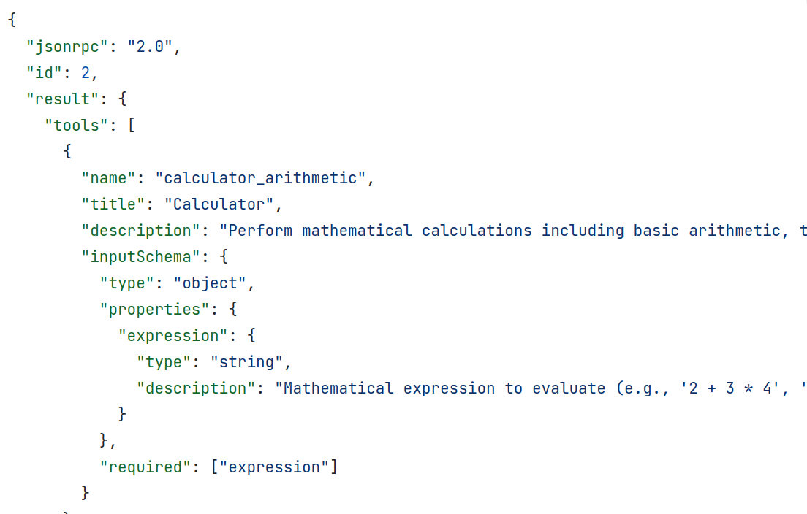

Slide 32
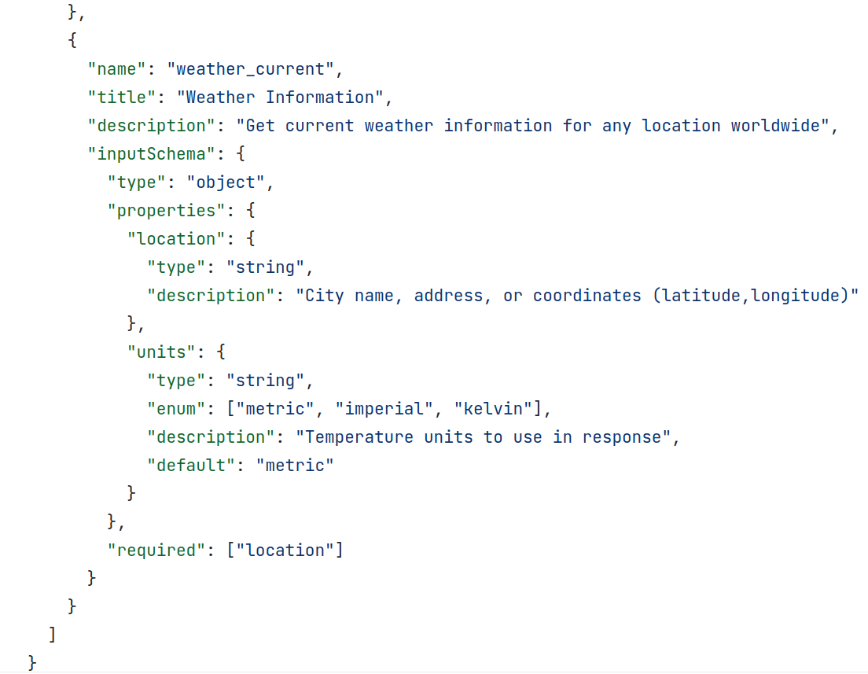

Slide 33
Understanding the Tool Discovery Request
The tools/list request is simple, containing no parameters.
The response contains a tools array that provides comprehensive metadata about each available tool.
This array-based structure allows servers to expose multiple tools simultaneously while maintaining clear boundaries between different functionalities.

Slide 34
Understanding the Tool Discovery Request
Each tool object in the response includes several key fields:
name: A unique identifier for the tool within the server’s namespace. Serves as the primary key for tool execution and should follow a clear naming pattern (e.g., calculator_arithmetic rather than just calculate)
title: A human-readable display name for the tool that clients can show to users

Slide 35
Understanding the Tool Discovery Request
description: Detailed explanation of what the tool does and when to use it
inputSchema: A JSON Schema that defines the expected input parameters, enabling type validation and providing clear documentation about required and optional parameters

Slide 36
How This Works in AI Applications
The AI application fetches available tools from all connected MCP servers and combines them into a unified tool registry that the language model can access.
This allows the LLM to understand what actions it can perform and automatically generates the appropriate tool calls during conversations.

Slide 37
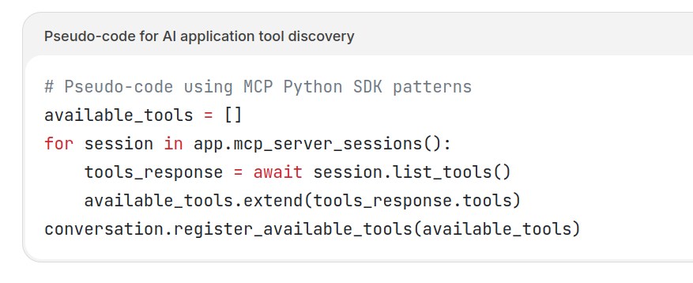
Pseudo-code for AI application tool discovery

Slide 38
Tool Execution (Primitives)
The client can now execute a tool using the tools/call method.
This demonstrates how MCP primitives are used in practice: after discovering available tools, the client can invoke them with appropriate arguments.

Slide 39
Understanding the Tool Execution Request
The tools/call request follows a structured format that ensures type safety and clear communication between client and server.
Note that we’re using the proper tool name from the discovery response (weather_current) rather than a simplified name:

Slide 40
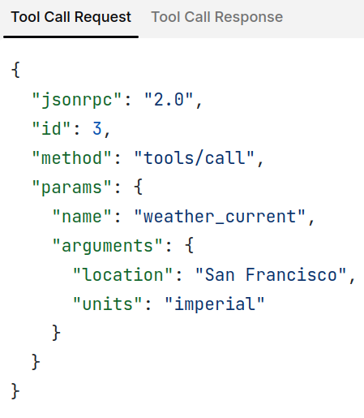
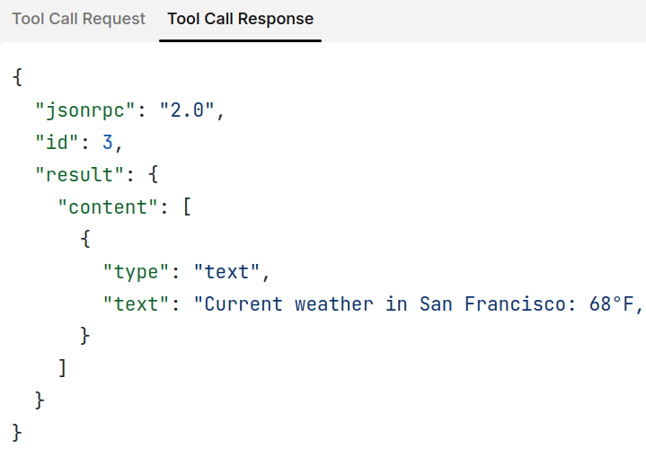

Slide 41
Key Elements of Tool Execution
Request structure includes several important components:
name: Must match exactly tool name from discovery response (weather_current). Ensures server to identify tool to execute.
arguments: Contains input parameters as defined by tool’s inputSchema. In this example:
location: “San Francisco” (required parameter)
units: “imperial” (optional, defaults to “metric” if not specified)
unique id for request-response correlation.

Slide 42
Understanding the Tool Execution Response
Response demonstrates MCP’s flexible content system:
content Array: Tool responses return an array of content objects, (text, images, resources, etc.)
Content Types: Each content object has a type field. In this example, "type": "text" indicates plain text content, but MCP supports various content types for different use cases.
Structured Output: Response provides actionable information that the AI application can use as context for language model interactions.

Slide 43
How This Works in AI Applications
When the language model decides to use a tool during a conversation, the AI application intercepts the tool call, routes it to the appropriate MCP server, executes it, and returns the results back to the LLM as part of the conversation flow.
Enables LLM to access real-time data and perform actions in the external world.

Slide 44
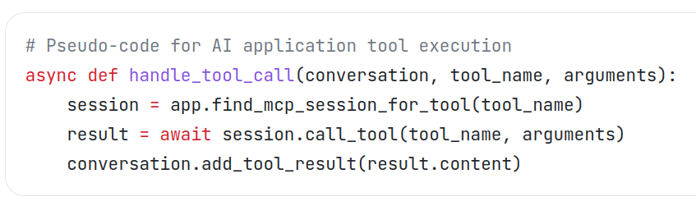
Pseudo-code for AI application tool execution

Slide 45
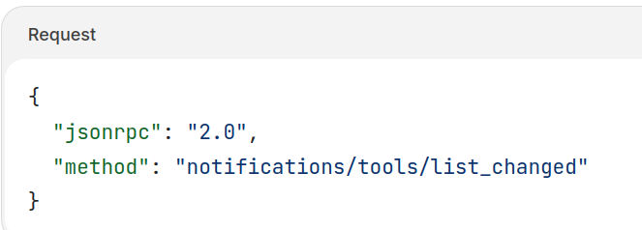
Understanding Tool List Change Notifications
When the server’s available tools change—such as when new functionality becomes available, existing tools are modified, or tools become temporarily unavailable—the server can proactively notify connected clients:

Slide 46
Key Features of MCP Notifications
No Response Required: Notice there’s no id field in the notification.
Capability-Based: Only sent by servers that declared "listChanged": true in their tools capability during initialization
Event-Driven: Server decides when to send notifications based on internal state changes, making MCP connections dynamic and responsive

Slide 47
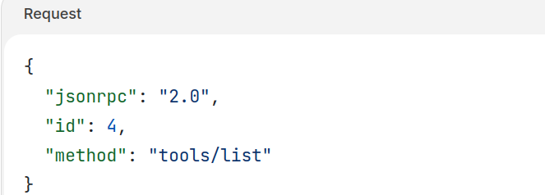
Client Response to Notifications
Upon receiving this notification, the client typically reacts by requesting the updated tool list. This creates a refresh cycle that keeps the client’s understanding of available tools current:

Slide 48
Why Notifications Matter
Dynamic Environments: Tools may come and go based on server state, external dependencies, or user permissions
Efficiency: Clients don’t need to poll for changes; they’re notified when updates occur
Consistency: Ensures clients always have accurate information about available server capabilities
Real-time Collaboration: Enables responsive AI applications that can adapt to changing contexts

Slide 49
How This Works in AI Applications
When the AI application receives a notification about changed tools, it immediately refreshes its tool registry and updates the LLM’s available capabilities.
This ensures that ongoing conversations always have access to the most current set of tools, and the LLM can dynamically adapt to new functionality as it becomes available.

Slide 50
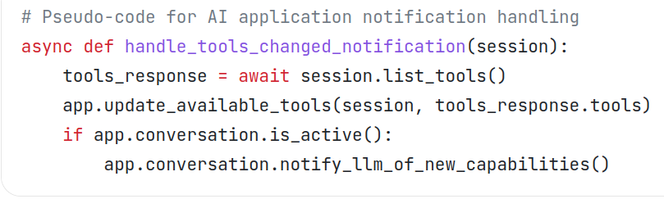
Pseudo-code for AI application notification handling

